Slide 1


Smart Movies for a Smart Company
{analysis by Aaron Galbraith 2023}

Slide 2
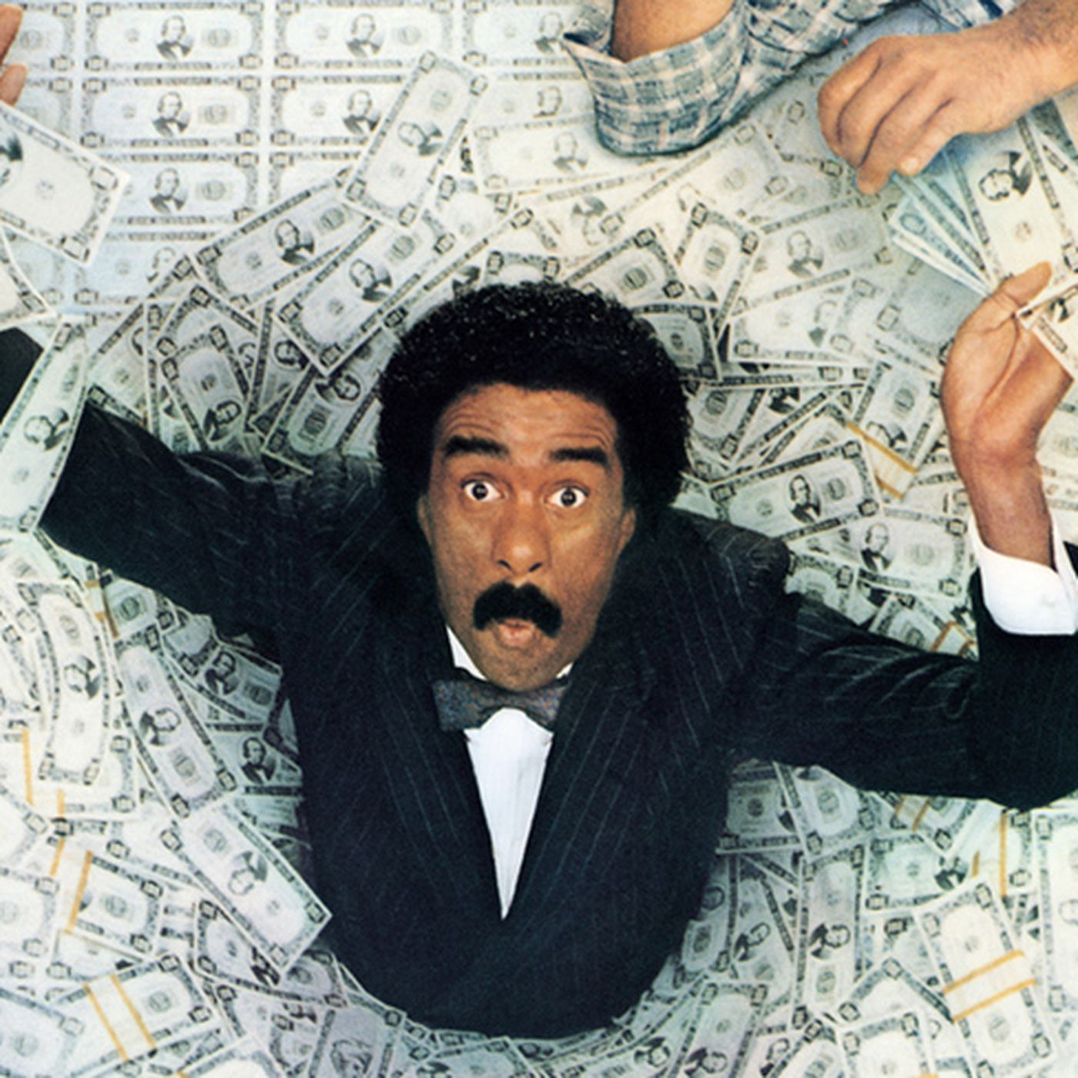

net profit … or return on investment?

Slide 3
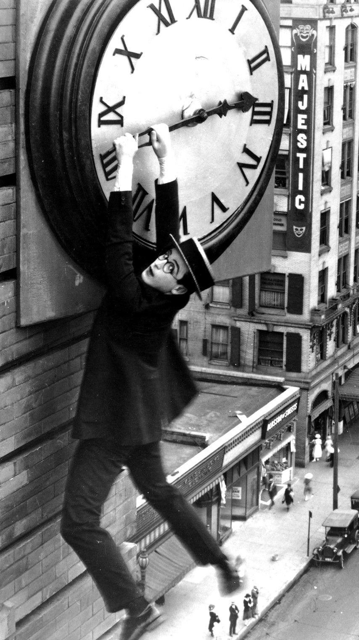
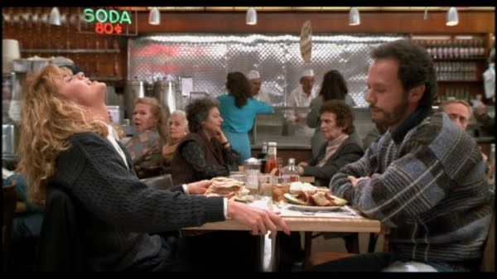
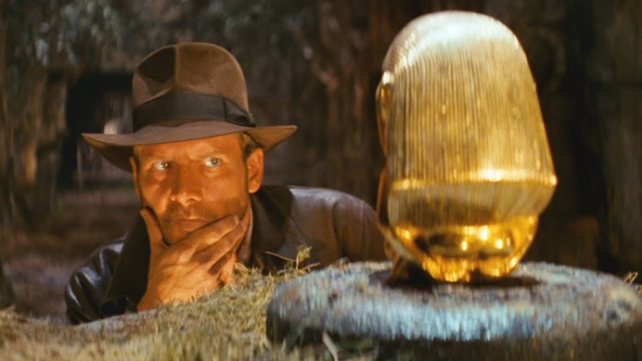
what generates success?

Slide 4



data resources

Slide 5
5,782 records
period: 1915-2020
budgets and grosses

Slide 6
17,712 records
period: 1914-2020
runtime, genre, MPAA rating, director

Slide 7
146,144 records
period: 2010-2020
runtime, genre, director, leads

Slide 8
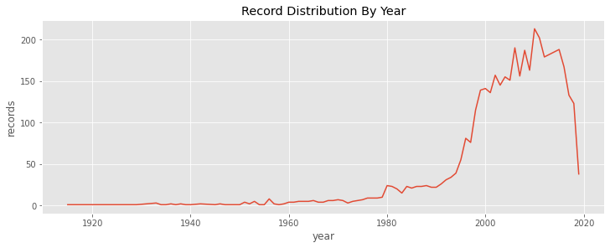
4,197 usable records

Slide 9
feature creation
(net) profit, ROI
adjustment for inflation
runtime intervals
distinct genres
past profit (of directors, of cast) *
past ROI (of directors, of cast) *

Slide 10
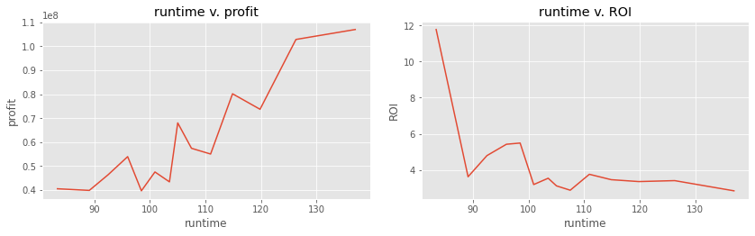
runtime

Slide 11
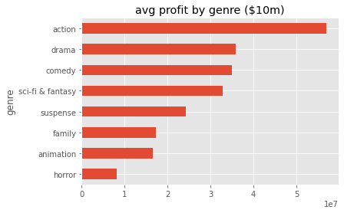
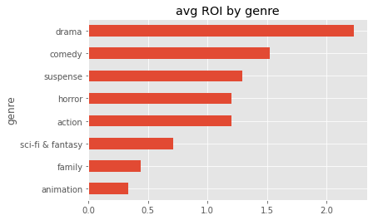
genre

Slide 12
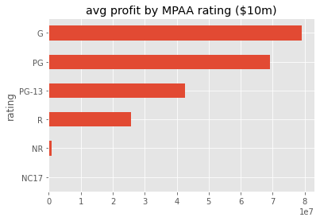
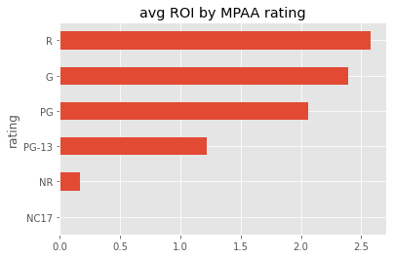
MPAA rating

Slide 13

“past profit” — an example
…
1981: Indiana Jones and the Temple of Doom
1985: The Color Purple
1987: Empire of the Sun
1989: Indiana Jones and the Last Crusade
1991: Hook
1993: Jurassic Park
1993: Schindler’s List
1997: The Lost World
1997: Amistad
1998: Saving Private Ryan
2001: A.I.
…
1993
dir. Steven Spielberg

Slide 14
Recommendations
Make a movie that’s 80-85 minutes long
Make it in the “horror” and/or “mystery” genre
Don’t worry about director experience

Slide 15
Thank you
Aaron Galbraith
www.linkedin.com/in/aarongalbraith

